Slide 1
RaktSetu
The Vein Valor
"Vein Valor" conveys the idea of individuals who display great courage and heroism by donating their blood to help those in need

Slide 2
AGENDA
Problem statement of project
Overview of the project
The target End users
Solution & the value proposition
The wow point of project
Modeling of the project
Results of the project
Meet our Team member

Slide 3
PROJECT OVERVIEW
our RaktSetu facility is designed to meet these needs :-
Objective: Our primary objective is to save lives by facilitating voluntary blood donations, raising awareness about the importance of donating blood, and engaging the community in a collective effort to ensure a steady flow of blood products for medical treatments and emergencies.
Safety: Our mission is to foster a culture of regular, voluntary blood donation and to inspire individuals to become heroes by saving lives through their contributions.

Slide 4
PROBLEM STATEMENT
Inadequate Blood Reserves: Our community often faces situations where blood banks and hospitals operate with limited blood reserves, leaving patients in need vulnerable.
Low Donor Participation: The number of voluntary blood donors remains below the ideal level required to meet the demand, and many eligible individuals do not participate in blood donation efforts.
Lack of Awareness: There is a general lack of awareness about the importance of regular, voluntary blood donation. This lack of awareness results in a missed opportunity to increase the donor pool.
Financial Constraints: Funding is essential for organizing blood donation drives and awareness campaigns, but we face financial constraints in sustaining and expanding our project.

Slide 5
WHO ARE THE END USERS?
Blood Donors: These are individuals who voluntarily donate their blood to contribute to the blood supply. They are the direct end users of the project, as their participation is essential to its success.
Patients in Need: Patients who require blood transfusions or blood products are the ultimate beneficiaries of the project. They receive the donated blood to save or improve their lives.
Healthcare Facilities: Hospitals, clinics, and healthcare centers are end users because they rely on a consistent and sufficient blood supply to provide medical treatments and perform surgeries.
Community Members: The broader community benefits from the project as it ensures access to life-saving blood products when needed. Community members may also participate in blood donation and support the project.
Volunteers: Volunteers who help organize and facilitate blood donation drives and awareness campaigns are important end users of the project, as they actively contribute to its

Slide 6
YOUR SOLUTION AND ITS VALUE PROPOSITION
Value Proposition
Impact
Regular blood donation drives ensure a consistent blood supply.
Diverse donor recruitment for a representative donor pool.
Extensive awareness campaigns inspire more donors.
Collaboration with healthcare facilities ensures efficient blood utilization.
Fundraising initiatives sustain and expand the project.
Saves lives, reduces mortality rates.
Enhances community health and well-being.
Engages the community in a life-saving mission.
Provides donor satisfaction and education.
Recognizes sponsors for their commitment to community welfare.

Slide 7
THE WOW IN YOUR SOLUTION
Health Assurance: We care about the well-being of our donors. As a token of our gratitude, we provide health insurance coverage to all our blood donors. This means that in addition to saving lives, you'll have peace of mind knowing you have health coverage in case you ever need it.
Donor Discounts: We believe in recognizing the dedication of our donors. Each time you donate blood, you earn points in our Donor Rewards Program. These points can be redeemed for discounts on future donations or even other health-related services.

Slide 8
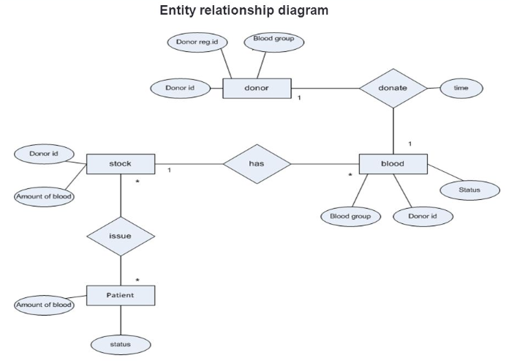
MODELLING

Slide 9
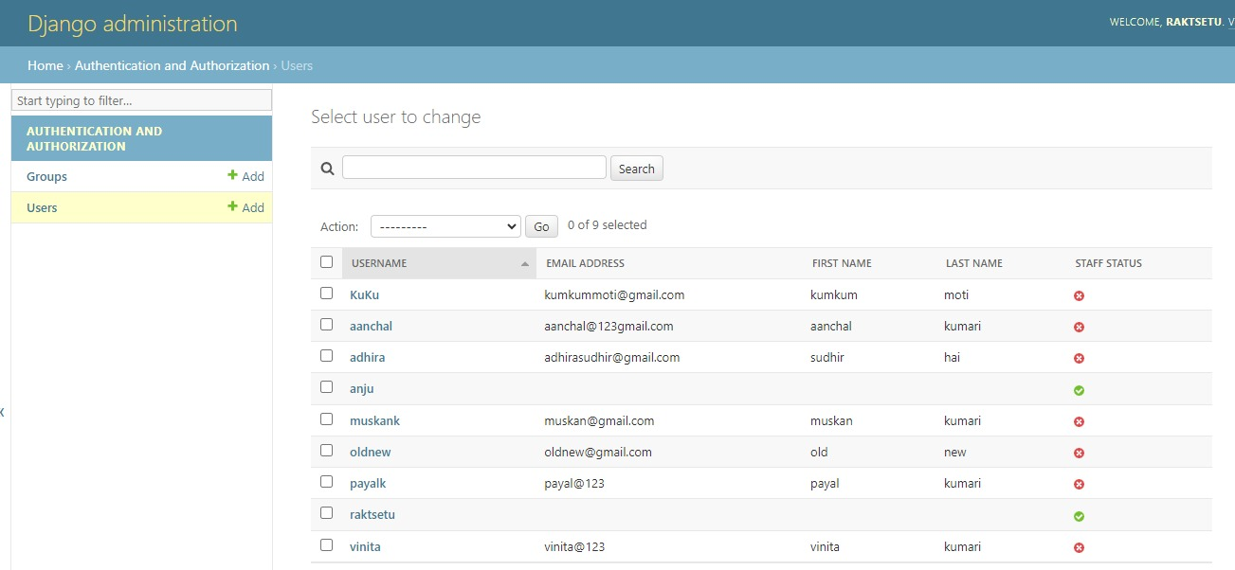
RESULTS

Slide 10
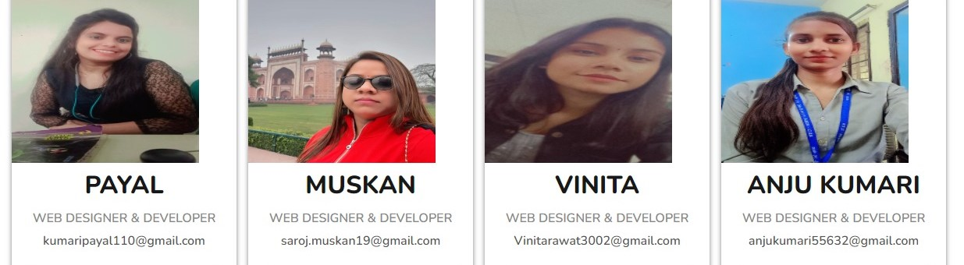
MEET OUR TEAM

